Slide 1

Exploiting Parallelism for FPGA Designs
By David Clarke
Final Year Project
Notes:
The title of my final year project is exploiting parallel-ism for FPGA designs.
The first question which is raised is what exactly is an FPGA?

Slide 2

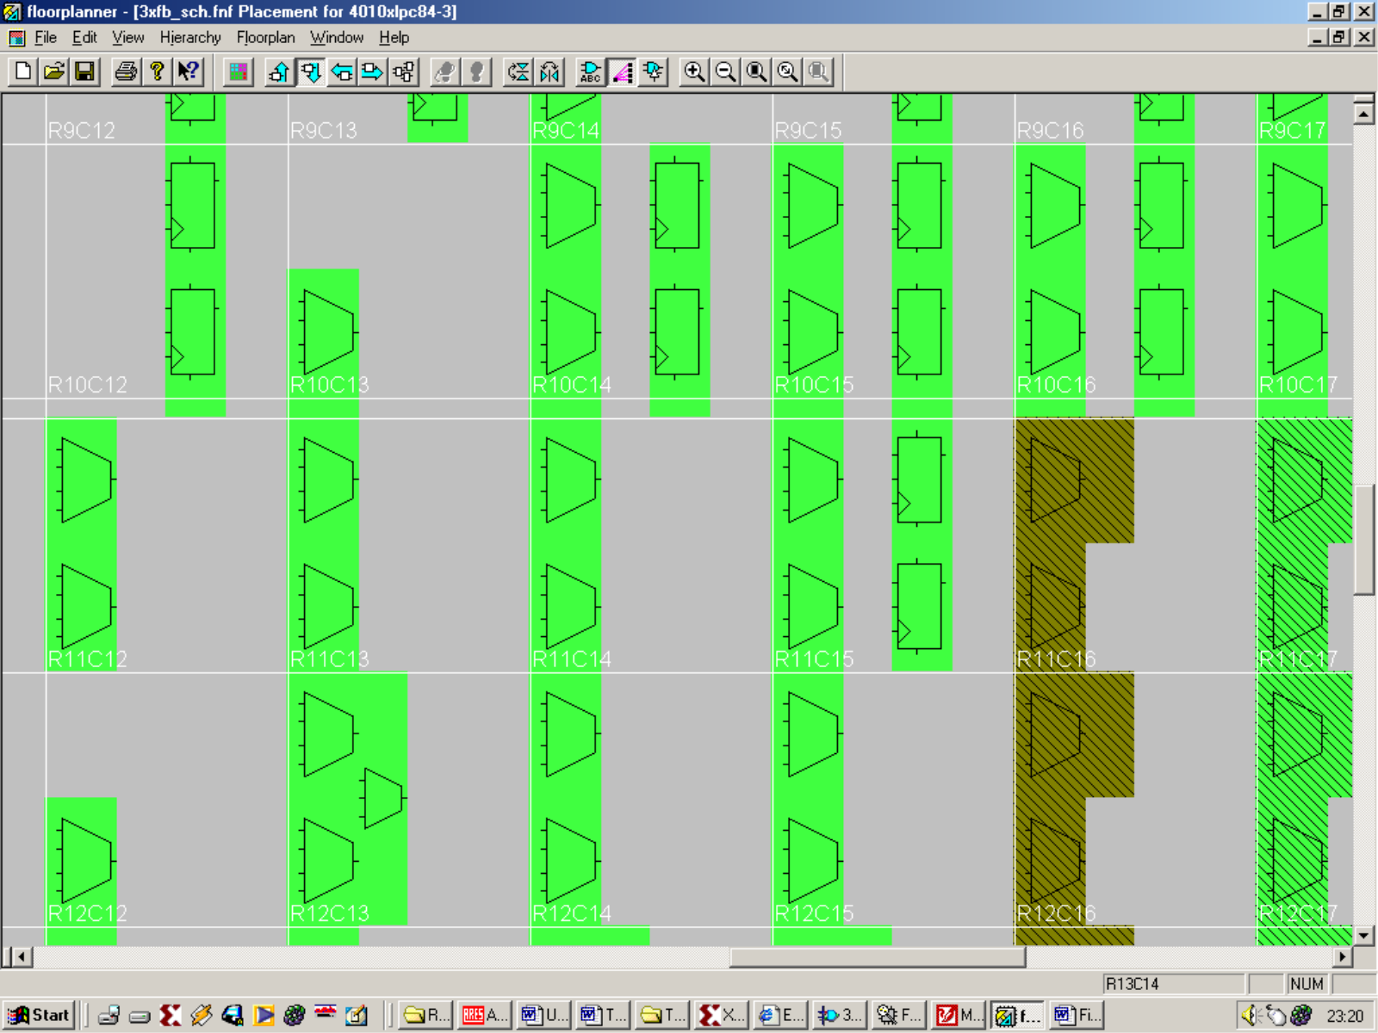
What Is An FPGA?
CLB
FPGA – field programmable gate array
A programmable microchip
Made up of complex logic blocks (CLB’s)
Notes:
FPGA – Field Programmable Gate Array
Hardware (a microchip) that is programmable much in the same way you can change a computer program by changing the instructions
Figure : Internal Layout of a standard FPGA
Made up of complex logic blocks (CLB’s) which are configured to implement different logic functions i.e. Combinational and sequential logic.
Great, so what function can exploit parallelism?

Slide 3
How Can Parallelism Be Exploited?
(A11 x B11) + (A12 x B21) + (A13 x B31) = P₁₁
(A21 x B11) + (A22 x B21) + (A23 x B31) = P₂₁
(A31 x B11) + (A32 x B21) + (A33 x B31) = P₃₁
(A11 x B12) + (A12 x B22) + (A13 x B32) = P₁₂
(A21 x B12) + (A22 x B22) + (A23 x B32) = P₂₂
(A31 x B12) + (A32 x B22) + (A33 x B32) = P₃₂
(A11 x B13) + (A12 x B23) + (A13 x B33) = P₁₃
(A21 x B13) + (A22 x B23) + (A23 x B33) = P₂₃
(A31 x B13) + (A32 x B23) + (A33 x B33) = P₃₃
Mathematical operations
Matrices
- Matrix multiplication
A11
A12
A13
B11
B12
B13
P11
P12
P13
A21
A22
A23
x
B21
B22
B23
=
P21
P22
P23
A31
A32
A33
B31
B32
B33
P31
P32
P33
Notes:
There are many complex mathematical functions available.
Matrix algebra offers a powerful group of operations.
Of these I chose matrix multiplication, as can be seen in the figure many individual calculations are required in order to achieve a result.
This mathematical operation could be split up into many calculations occurring at the same time.
The products and sums could be generated in a parallel fashion in the target FPGA.
What tests then, could be undertaken to show exploitation of matrix multiplication in a parallel architecture?

Slide 4
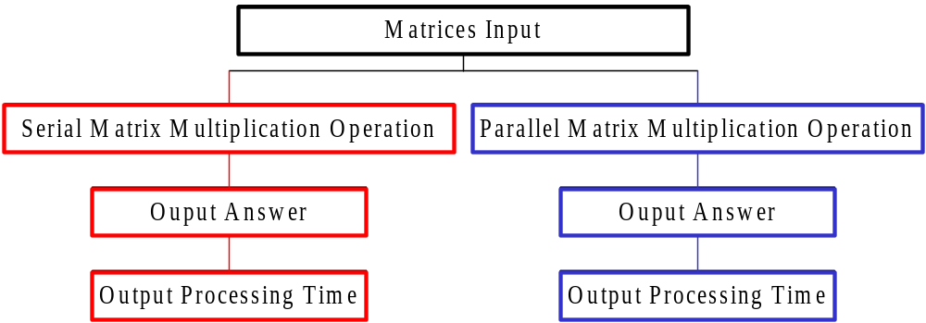
What Test Could Be Undertaken to Show Exploitation of Parallelism?
Processing comparison –
Parallel architecture vs. Serial architecture
Figure: Initial Design Flow
Notes:
A processing comparison could be undertaken. Compare processing power of a parallel matrix multiplier architecture against that a serial one. As shown in the above figure.
With these ideas in mind the aim of the project could now be stated.

Slide 5
Aim of the Project
To investigate, design and build a FPGA based matrix multiplier, which would be used in alternative serial and parallel matrix multiplication. The system researched will be used to monitor the processing speed difference between the two entities.
Notes:
With this aim in mind the system could begin to take shape, but not before a few lessons on FPGA based design was researched. Which leads me onto my next slide.

Slide 6
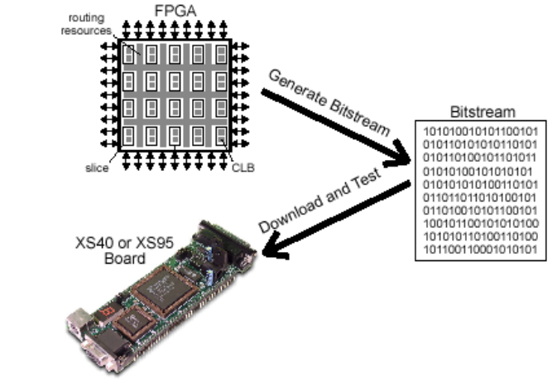
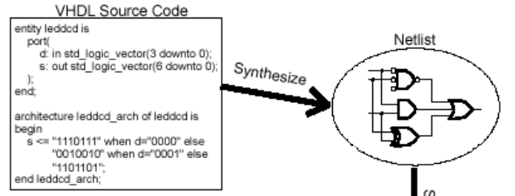
How Will the Design Be Implemented?
Implement
Figure: A VHDL design flow
Notes:
This shows the design cycle for implementation of VHDL into an FPGA on a test board.
A description of the logic circuit is entered using a hardware description language (HDL) such as VHDL.
A synthesizer tool is used to transform the VHDL into a netlist. The netlist is just a description of the various logic gates in the design and how they are interconnected.
The fitter places gates from your netlist in various CLBs and opens or closes switches in the routing resources to wire the gates together. Once the implementation is complete, the state of the routing switches and CLBs is extracted to create a bitstream where the ones and zeroes correspond to open or closed switches.
The bitstream is downloaded into a physical FPGA, upon completion of the downloading, the FPGA will perform the operations specified by the VHDL code.

Slide 7
Constraints on the Design
Four matrix multiplications available
Maximum size of input matrices 3 rows by 3 columns
Matrix_A Matrix_B
Maximum magnitude of a matrix element is 3
One system used to processes matrix data either serially or in parallel.
3
3
3
3
3
3
3
3
3
3
3
3
3
3
3
3
3
3
Notes:
To keep ideas simple a few rules were laid down. This kept the design small enough not to take up too much FPGA real estate.
The four matrix multiplications are shown in later slides
The matrices elements magnitude may not exceed the value 3, 2BITS in binary
One system is used to implement a serial and parallel system. Two separate systems would not fit into the system.

Slide 8
How to Operate the System
Select Matrix Mode
Mode 0 = 0 0 0
……… .. . . .
……… .. . . .
Mode 7 = 1 1 1
Input matrix data in binary format
Probe the output of the system
LSB’s - Selects Matrix Size
MSB - Selects Serial or Parallel Processing
Notes:
Three bits wide
Most significant bit signifies to the system, perform either a serial (0) or a parallel (1) matrix multiplication.
The two least significant bits indicate to the system what size matrices will be encountered
000 = 0 = Serial Matrix Multiplication, (2x2) by a (2x2)
100 = 4 = Parallel Matrix Multiplication, (2x2) by a (2x2)
001 = Serial Matrix Multiplication, (2x3) by a (3x2)
101 = Parallel Matrix Multiplication, (2x3) by a (3x2)
010 = Serial Matrix Multiplication, (2x3) by a (3x3)
110 = Parallel Matrix Multiplication, (2x3) by a (3x3)
011 = Serial Matrix Multiplication, (3x3) by a (3x3)
111 = Parallel Matrix Multiplication, (3x3) by a (3x3)

Slide 9

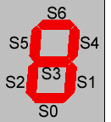
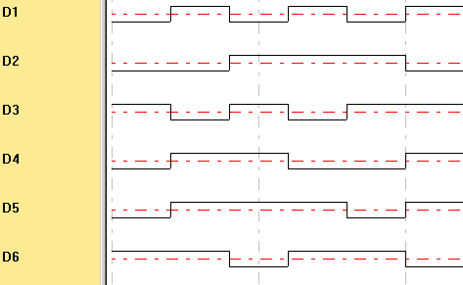
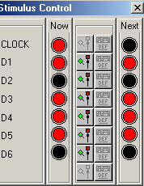

How Will Data Be Inputted and Outputted From the System?
Input Data
3-Bit Dip switches
– To select Matrix Mode
WinXSport
– Input matrices data into the system
Output Data
Pod-a-lyzer
– Acquires data from the system
Notes:
By using a program called WinXSport, data can be downloaded to the XS40 board through the PC Parallel port.
Pod-a-lyzer acquires data from the system when an event happens to the outputs of the system. In this case, when the signal start goes high data is acquired at the speed of the internal clock.

Slide 10
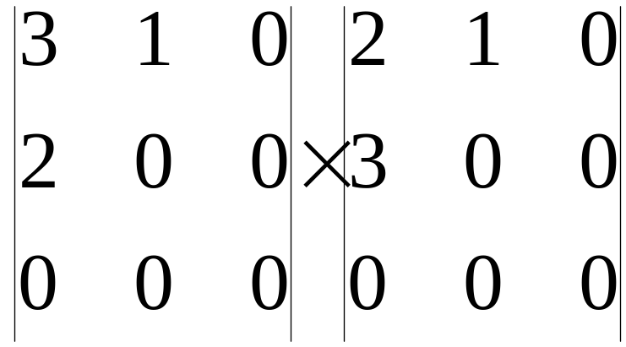
Converting data for the WinXSport program
(2x2) by a (2x2) result is a 2x2
Decimal 1 demensional equivalent of the matrices data 310200000210300000
Bit stream, made up of two bit numbers 110100100000000000100100110000000000
Split the bit stream up into six bit segments starting with the LSB 110100 100000 000000 100100 110000 000000
Reverse each set of six bits, input into the XSport program 001011 000001 000000 001001 000011 000000
Notes:
To enter matrix data into the WinXSport program, a conversion is required.
Take for example inputting two 2x2 matrices. Pad out the matrices to fit a two 3x3 templates, because this system caters for two 3x3 matrices multiplications logic zeros must be entered in the appropriate gaps.
Read matrix data, row by row, matrix A first, matrix B afterwards.
Convert each element into it’s two bit binary equivalent. 36-bits of information is entered into the system.
Split up into six bit segments, reverse each set of six bits, enter into WinXSport program.

Slide 11
Layout of System
MATRIX MODE
(3BITS)
CONTROLLER
ENABLE_COUNTER
Counter
SEL_PROD_ELEMENT
CNTR_OUTPUT
START
Data Store
Multipliers
Adders
Seven Seg Enc
MATRIX
DATA
INPUT
(6-BITS)
ELEMENT
OUTPUT
(14BITS)
Matrix Multiplier
Notes:
The most important part of this whole system is the matrix multiplier

Slide 12
In Depth Look at the Matrix Multiplier
(A11 x B11) + (A12 x B21) + (A13 x B31)
(A11 x B11)
A11
2BIT MUL1
4BIT ADDER1
B11
(A12 x B21)
A12
2BIT MUL2
B21
(A13 x B31)
A13
2BIT MUL3
B31
--
--
--
--
(A31 x B13) + (A32 x B23) + (A33 x B33)
(A31 x B13)
A31
2BIT MUL25
4BIT ADDER9
B13
(A32 x B23)
A32
2BIT MUL26
B23
(A33 x B33)
A33
2BIT MUL27
B33
Notes:
If a two 3x3 matrices were multiplied together, to gain the matrix product, 27 multiplications and 9 additions would be involved.
The multiplication operations are performed first, then the additions are performed afterwards.
This system performs matrix multiplication on matrices up to the size of two 3x3’s in a serial or parallel fashion.

Slide 13
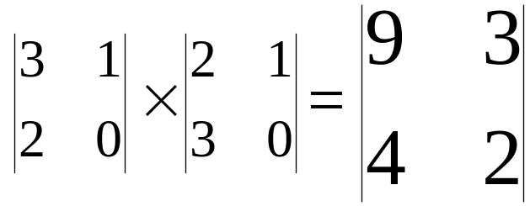


Matrix Multiplication,
(2x2) by a (2x2)
Processing Count
(clock cycles)
8
01
Matrix Mode 0 – Serial Processing
Matrix Mode 4 – Parallel Processing
Notes:
Here are a few examples of results achieved by the matrix multiplier.
Converting the matrix data into a form that can read by the winXSport simulator is the most difficult part.
Because this system caters for four matrix multiplications, with the largest input matrices having the dimensions 3x3.
The simulation results are in hexadecimal format and are are coded for a seven segment display.
The very last hex number is the processing count, I.e. clock cycles required to create an answer.

Slide 14
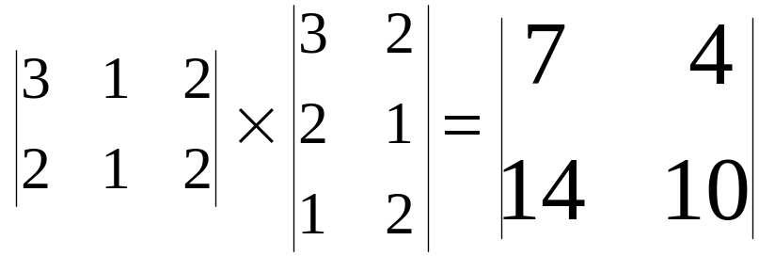


Matrix Multiplication,
(2x3) by a (3x2)
Processing Count
(clock cycles)
12
01
Matrix Mode 1 – Serial Processing
Matrix Mode 5 – Parallel Processing

Slide 15
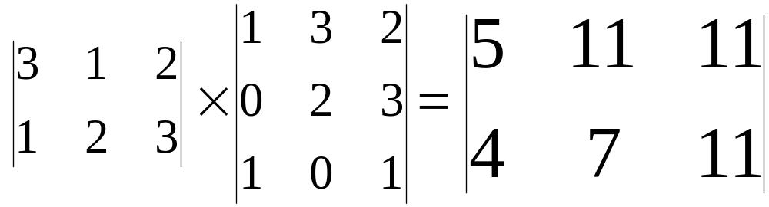


Matrix Multiplication,
(2x3) by a (3x3)
Processing Count
(clock cycles)
15
Matrix Mode 2 – Serial Data Processing
01
Matrix Mode 6 – Parallel Data Processing

Slide 16
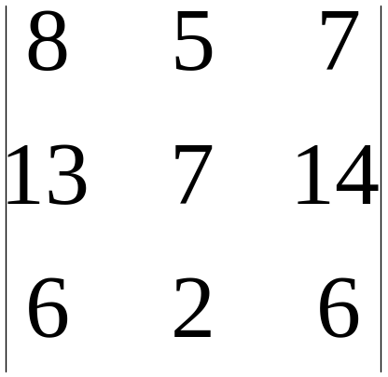
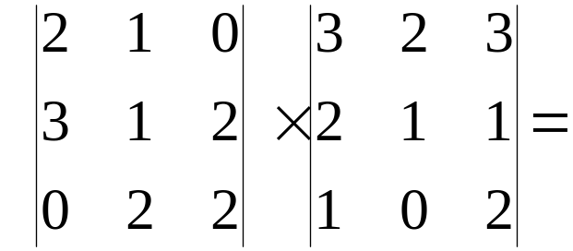


Matrix Multiplication,
(3x3) by a (3x3)
Processing Count
(clock cycles)
18
Matrix Mode 3 – Serial Data Processing
01
Matrix Mode 7 – Parallel Data Processing

Slide 17
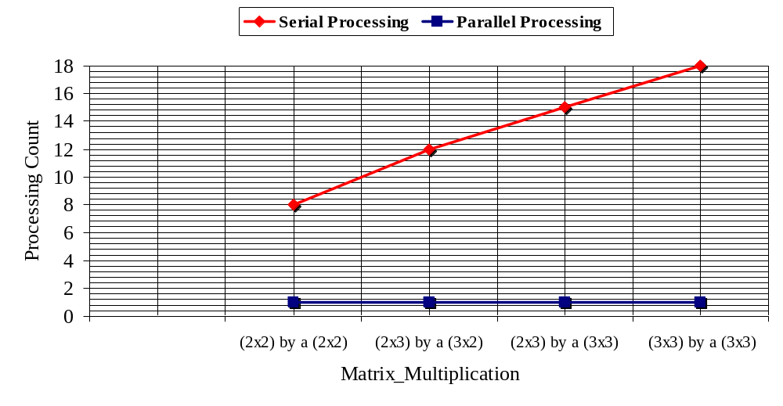
Serial and Parallel Matrix Multiplication, a comparison
Notes:
A Graph to show how the processing count alters with size of input matrices, using serial and parallel matrix multiplication

Slide 18
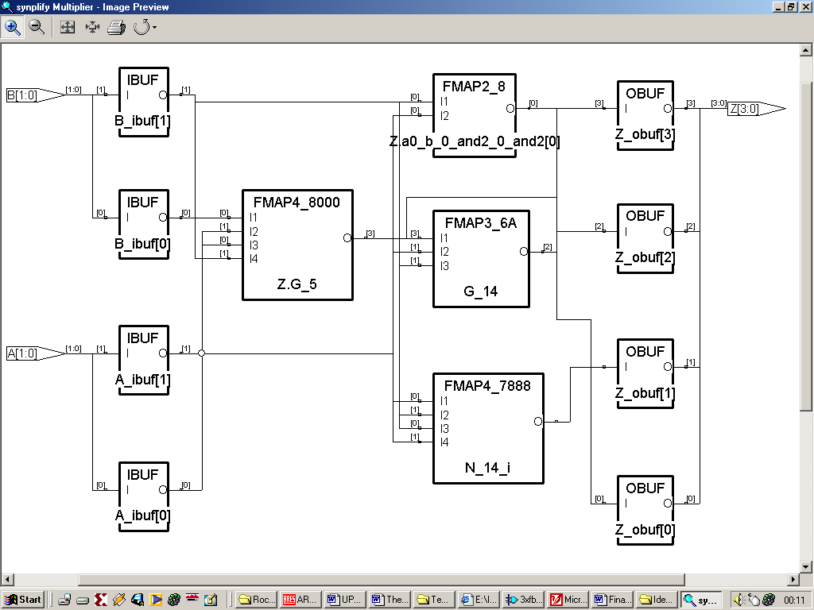
A Synthesised Behavioural VHDL Model of a 2BIT multiplier
ENTITY MUL_2x2 IS
PORT(A11,B11 : IN UNSIGNED(1 downto 0);
-- 2, 2bit inputs
AB11 : OUT UNSIGNED(3 downto 0));
-- 1, 4bit output
END ENTITY MUL_2x2;
ARCHITECTURE BEH OF MUL_2x2 IS
Begin
AB11 <= A11 * B11;
End architecture BEH;
Code : Behavioural VHDL code for a 2Bit Multiplier
Figure : Synthesised 2Bit Multiplier using Synplify Synplicity
Notes:
Shown above is a behavioural description of a 2bit matrix multiplier.
One could describe the same multiplier structurally(the manner in which the logic is interconnected), the VHDL script would take up two sides of A4.

